Slide 1
Microsoft Productivity Apps
Apps for today and tomorrow

Slide 2
Goals and Objectives
  Introduction to Microsoft productivity Apps
  Definition of Productivity Apps
  Video
  Descriptions of specific Microsoft productivity apps
  Importance of Microsoft productivity Apps

Slide 3
Introduction
Employee productivity is the measure of the efficiency of a particular worker or team of workers. These software serve to increase the efficiency of this workers by facilitating their work.
These are Microsoft apps that have been designed at the Microsoft garage that enable mobile users to get the same Microsoft services that they get in their computers both desktops and personal computers.
Productivity apps are software devoted to making our work easier and our live more productive. This apps help one to do his personal job or task faster, efficiently and more cheaply
Notes:
The latest edition of excel, word, OneNote, outlook, access and publisher are designed to work touch screens as well as laptops and desktops. Microsoft has endeavored to not just to improve the experience of users across board but has redefined the nature of productivity and its boundaries.

Slide 4

Video 1
Notes:
link
https://support.office.com/en-us/article/Get-started-at-Office-com-91a4ec74-67fe-4a84-a268-f6bdf3da1804

Slide 5
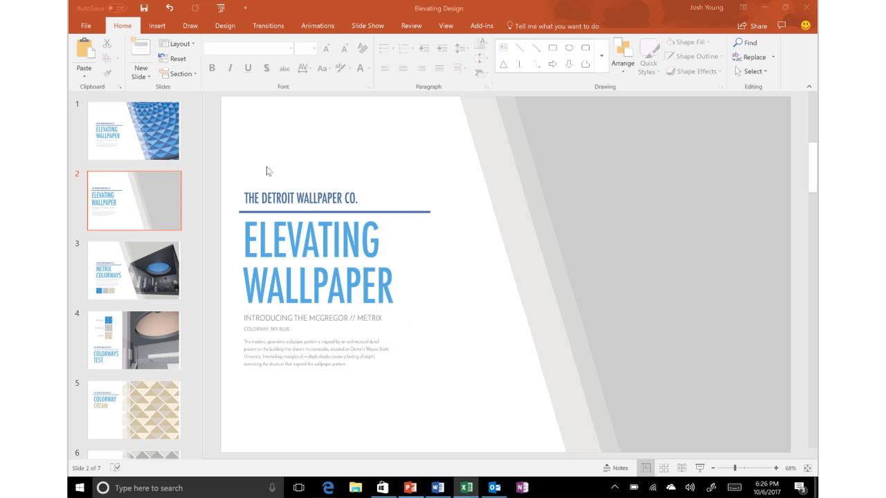
Video 2
Notes:
Video on wallpaper elevation

Slide 6
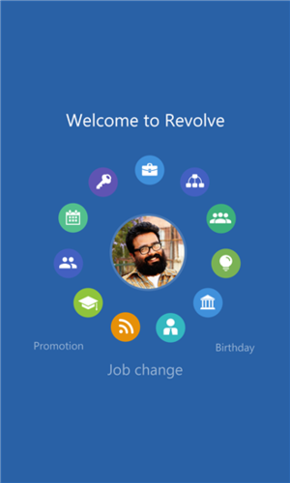
Millennial and technology
The list of Microsoft productivity apps include:
Resolve
  This app is private beta in the windows phone app store. The app prepares one for all conversations in every meeting.
Notes:
It works in the background to locate and display insights about people one is going to meet. The app can be a valuable tool for salespeople as it will provided them with information of their target client , for instance their like and dislikes.

Slide 7
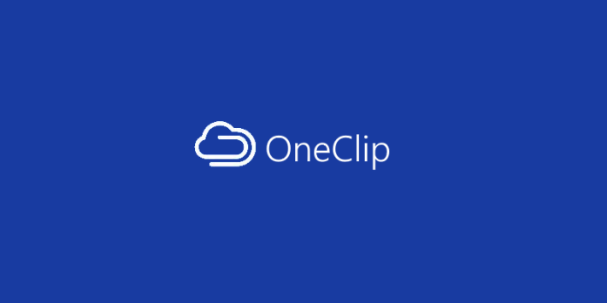
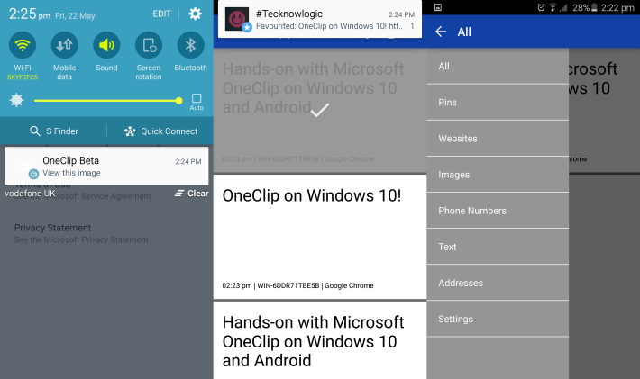
Oneclip
It is another app in windows phone private beta.
Oneclip
It is the perfect solution for moving snippets of data like texts, photos and URLs, from one platform to another including android, iOS, windows PCs and Windows phones.
Notes:
There is a sync folder between ones PC and phone so that content can room back and forth. It makes it more continent for windows PC users.

Slide 8
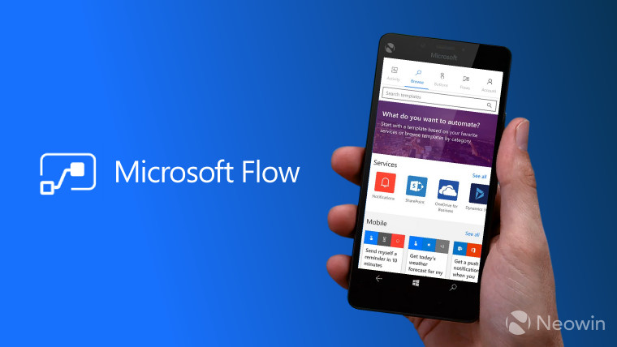
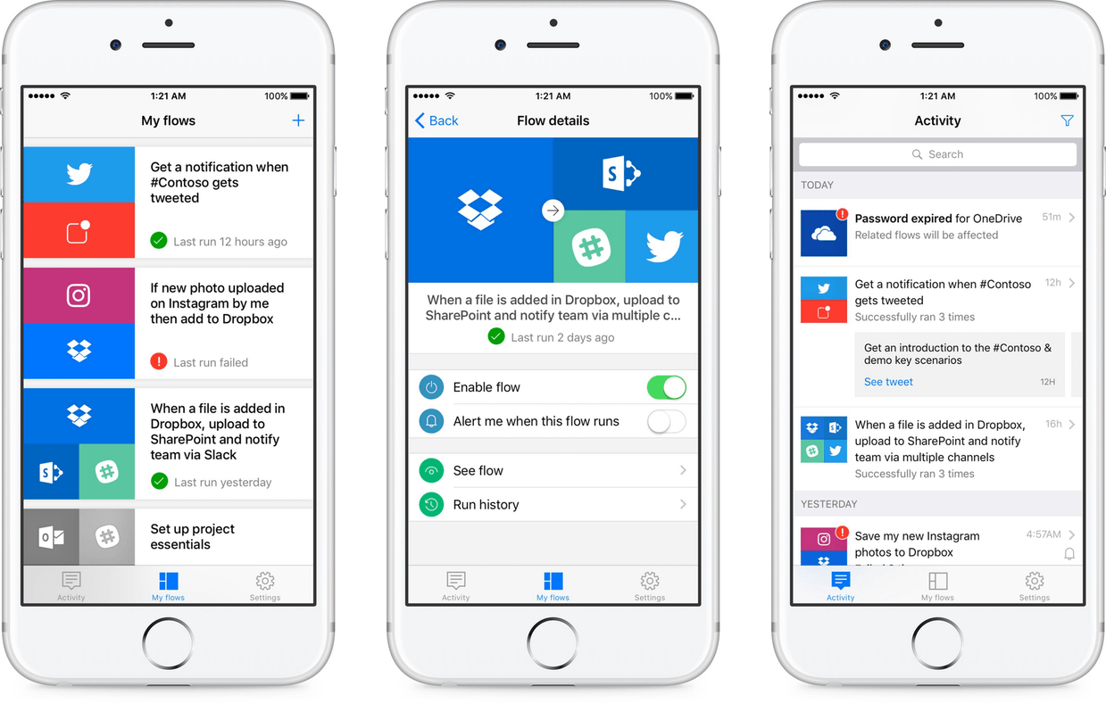
Flow
  This is a strip down version of outlook that emphasizes on chatting rather than formal email back and forth. It works just like the Facebook messengers narrowing the line between real time emails and messages is blurred.

Slide 9
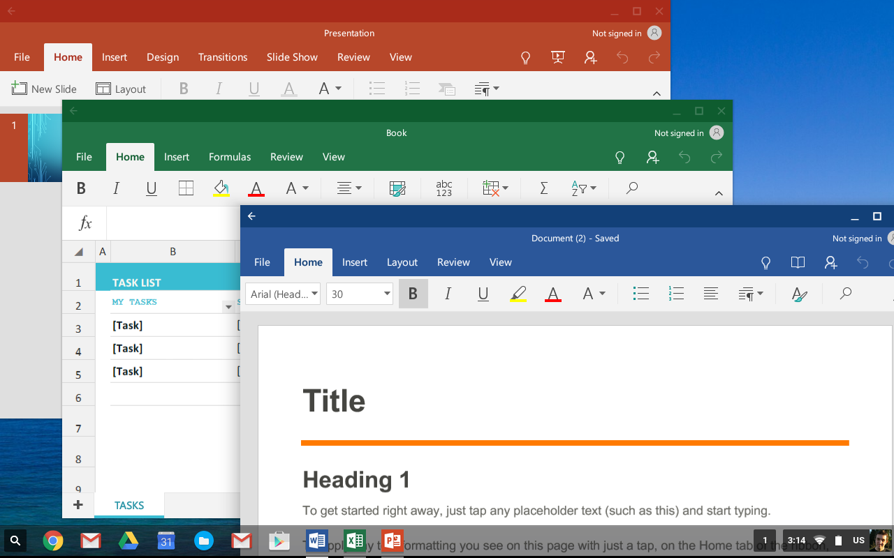
Office now
It is the office assistant, the project that Microsoft Bill Gates was working on.
  It has some similarities with Google now. It is a focused version of Cortana.
Notes:
Feature that have been incorporated into the app allows one to speed on way to meetings, today and tomorrow.
Travel card notes any offshore meeting in one calendar to tomorrow and atypical notifications that alert one of meeting room changes or booking.
The lock screen of one’s window phone will give you your schedule, the time you will spend in each meeting and when the last one will take place in the day.

Slide 10
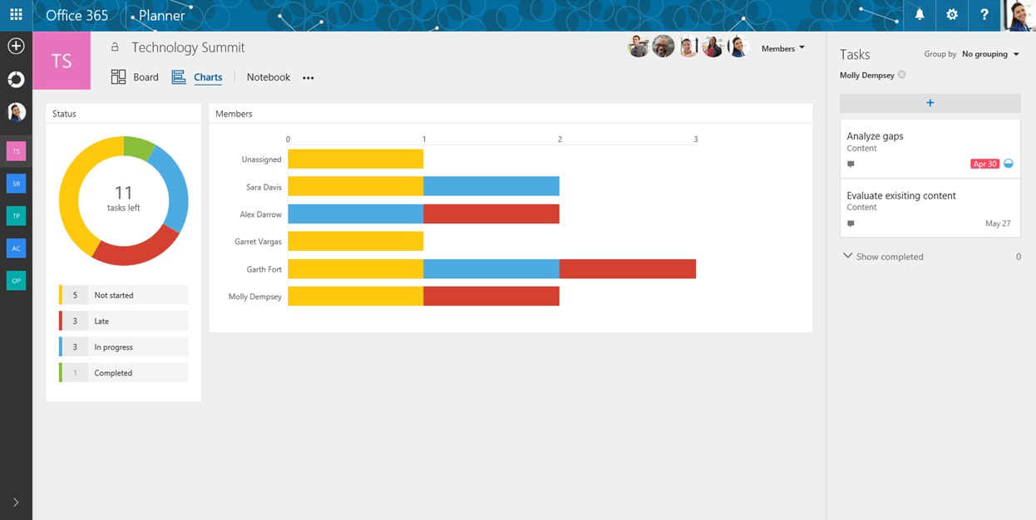
Microsoft planner
Those apps enable one to organize his schedule well ahead of time.

Slide 11
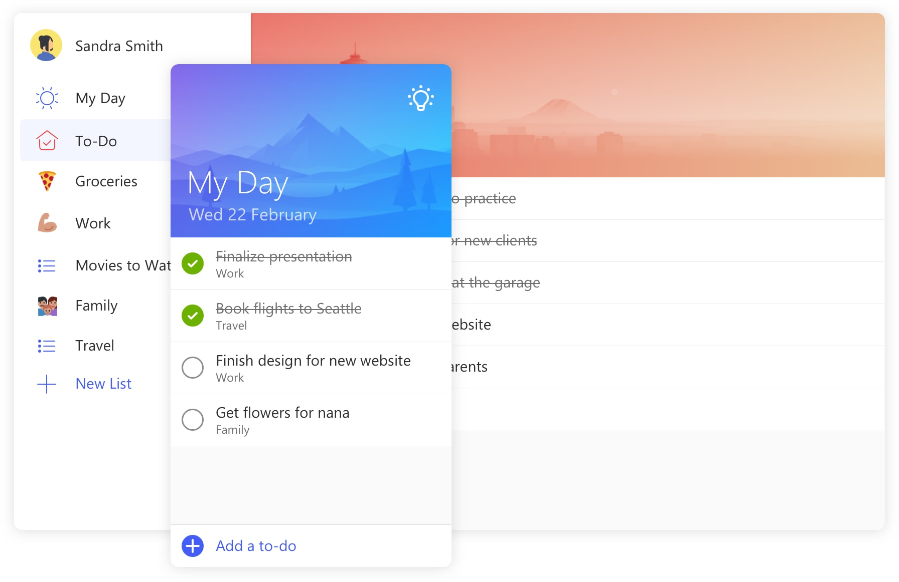
Microsoft to do
  This app makes it easy for one to plan his day ahead of time.
  It helps one increase his productivity and reduce stress.
This app arranges tasks in order of importance and ensure that all tasks are completed well ahead of time.
Notes:
It combines a beautiful design and intelligence technology to enable one create a simplified work flow.

Slide 12
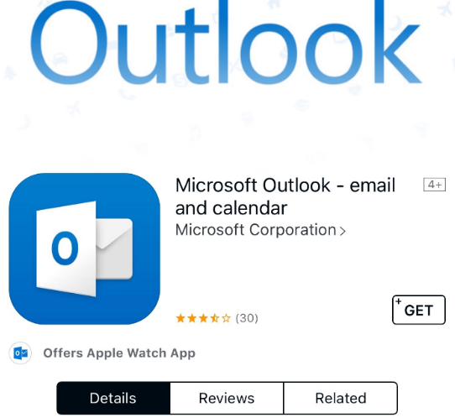
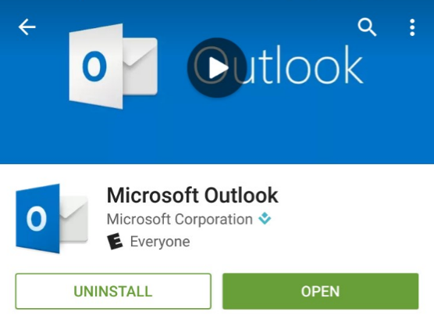
The outlook app
  This app makes ones email to present more relevant information to the senders who have LinkedIn apps

Slide 13
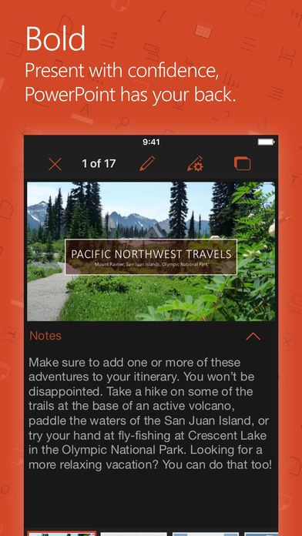
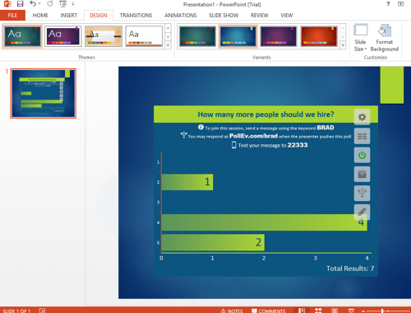
The PowerPoint app
This app enables one to add dynamic polls to his presentation so as to interact with audience with poll everywhere.
It also shows word cloud on presentations in pro word cloud.

Slide 14
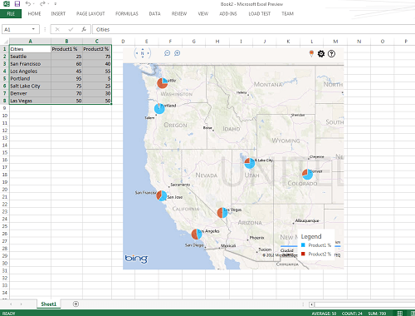
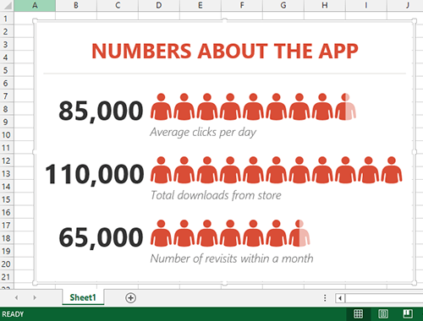
Excel app
  This app provides extra charts or graphs or stunning maps from Bing Maps.
  It shows information that is appealing and easily to understand with people graph.

Slide 15
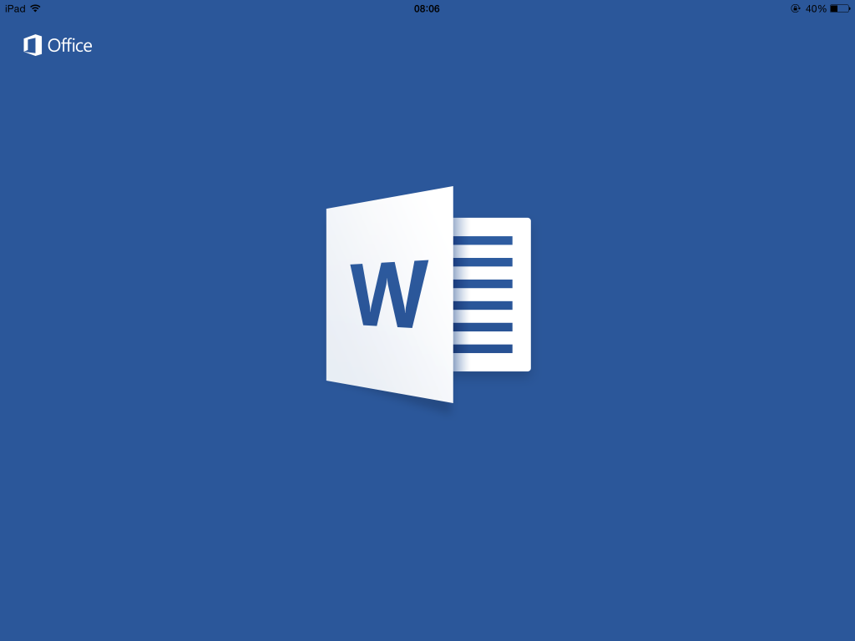
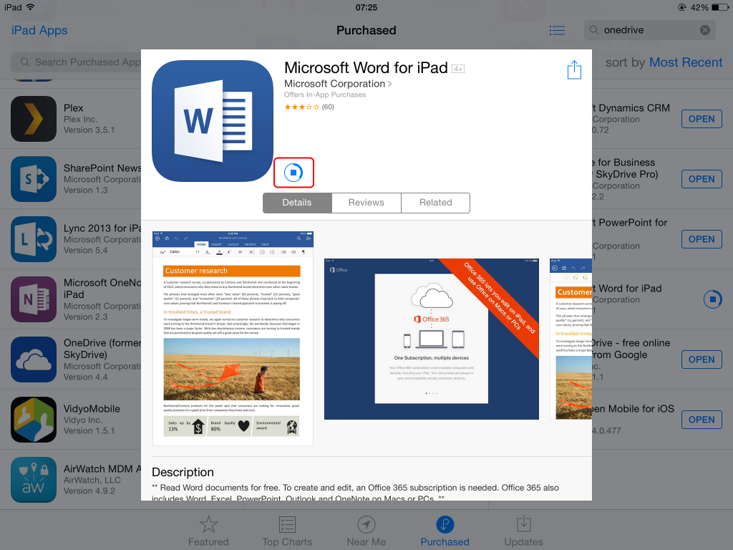
Word app
This app enables one to look for information about the content on ones document without the need to leave word by only selecting texts using the Wikipedia app. Apart from these, it has a work translator that allows quick translation of texts.

Slide 16
Importance Of Microsoft Productivity Apps
These apps make people to feel like that they are utilizing their day time the well by squeezing more into each day.
Office time management apps are relatively more complicated than personal ones due to the need to accommodate different time different types of data recording.
These apps let one to monitor their progress based on their set objectives and restate their plans based on the lessons they have learns and their plans.
Notes:
Office apps also separate personal from professional tasks and allow employees to report only work related data to avoid breach of privacy or other legal grey areas.
A though research around these apps is lacking. The app help an employee on focus on what he wants to achieve, apart from keeping track of time.
This has led to a die-hard customer base from individuals that use these app.

Slide 17
References
Azfar, A., Choo, K. K. R., & Liu, L. (2017). Forensic taxonomy of android productivity apps. Multimedia Tools and Applications, 76(3), 3313- 3341.
Carey, P., DesJardins, C., Shaffer, A., Shellman, M., & Vodnik, S. (2016). New Perspectives Microsoft Office 365 & Office 2016: Introductory, Loose- leaf Version.
Mark, G., Iqbal, S., & Czerwinski, M. (2017, September). How blocking distractions affects workplace focus and productivity. In Proceedings of the 2017 ACM International Joint Conference on Pervasive and Ubiquitous Computing and Proceedings of the 2017 ACM International Symposium on Wearable Computers (pp. 928-934). ACM.
Parsons, J. J., Beskeen, D. W., Cram, C. M., Duffy, J., & Friedrichsen, L. (2016). Bundle: Illustrated Computer Concepts and Microsoft Office 365 & Office 2016+ LMS Integrated SAM 365 & 2016 Assessments, Trainings, and Projects with 1 MindTap Reader Printed Access Card. Cengage Learning.

